Slide 1



Skillset report - Balaji Dhamodaran
View in Power BI
Last data refresh:
10/11/2025 06:39:54 UTC
Downloaded at:
10/11/2025 06:40:59 UTC

Slide 2
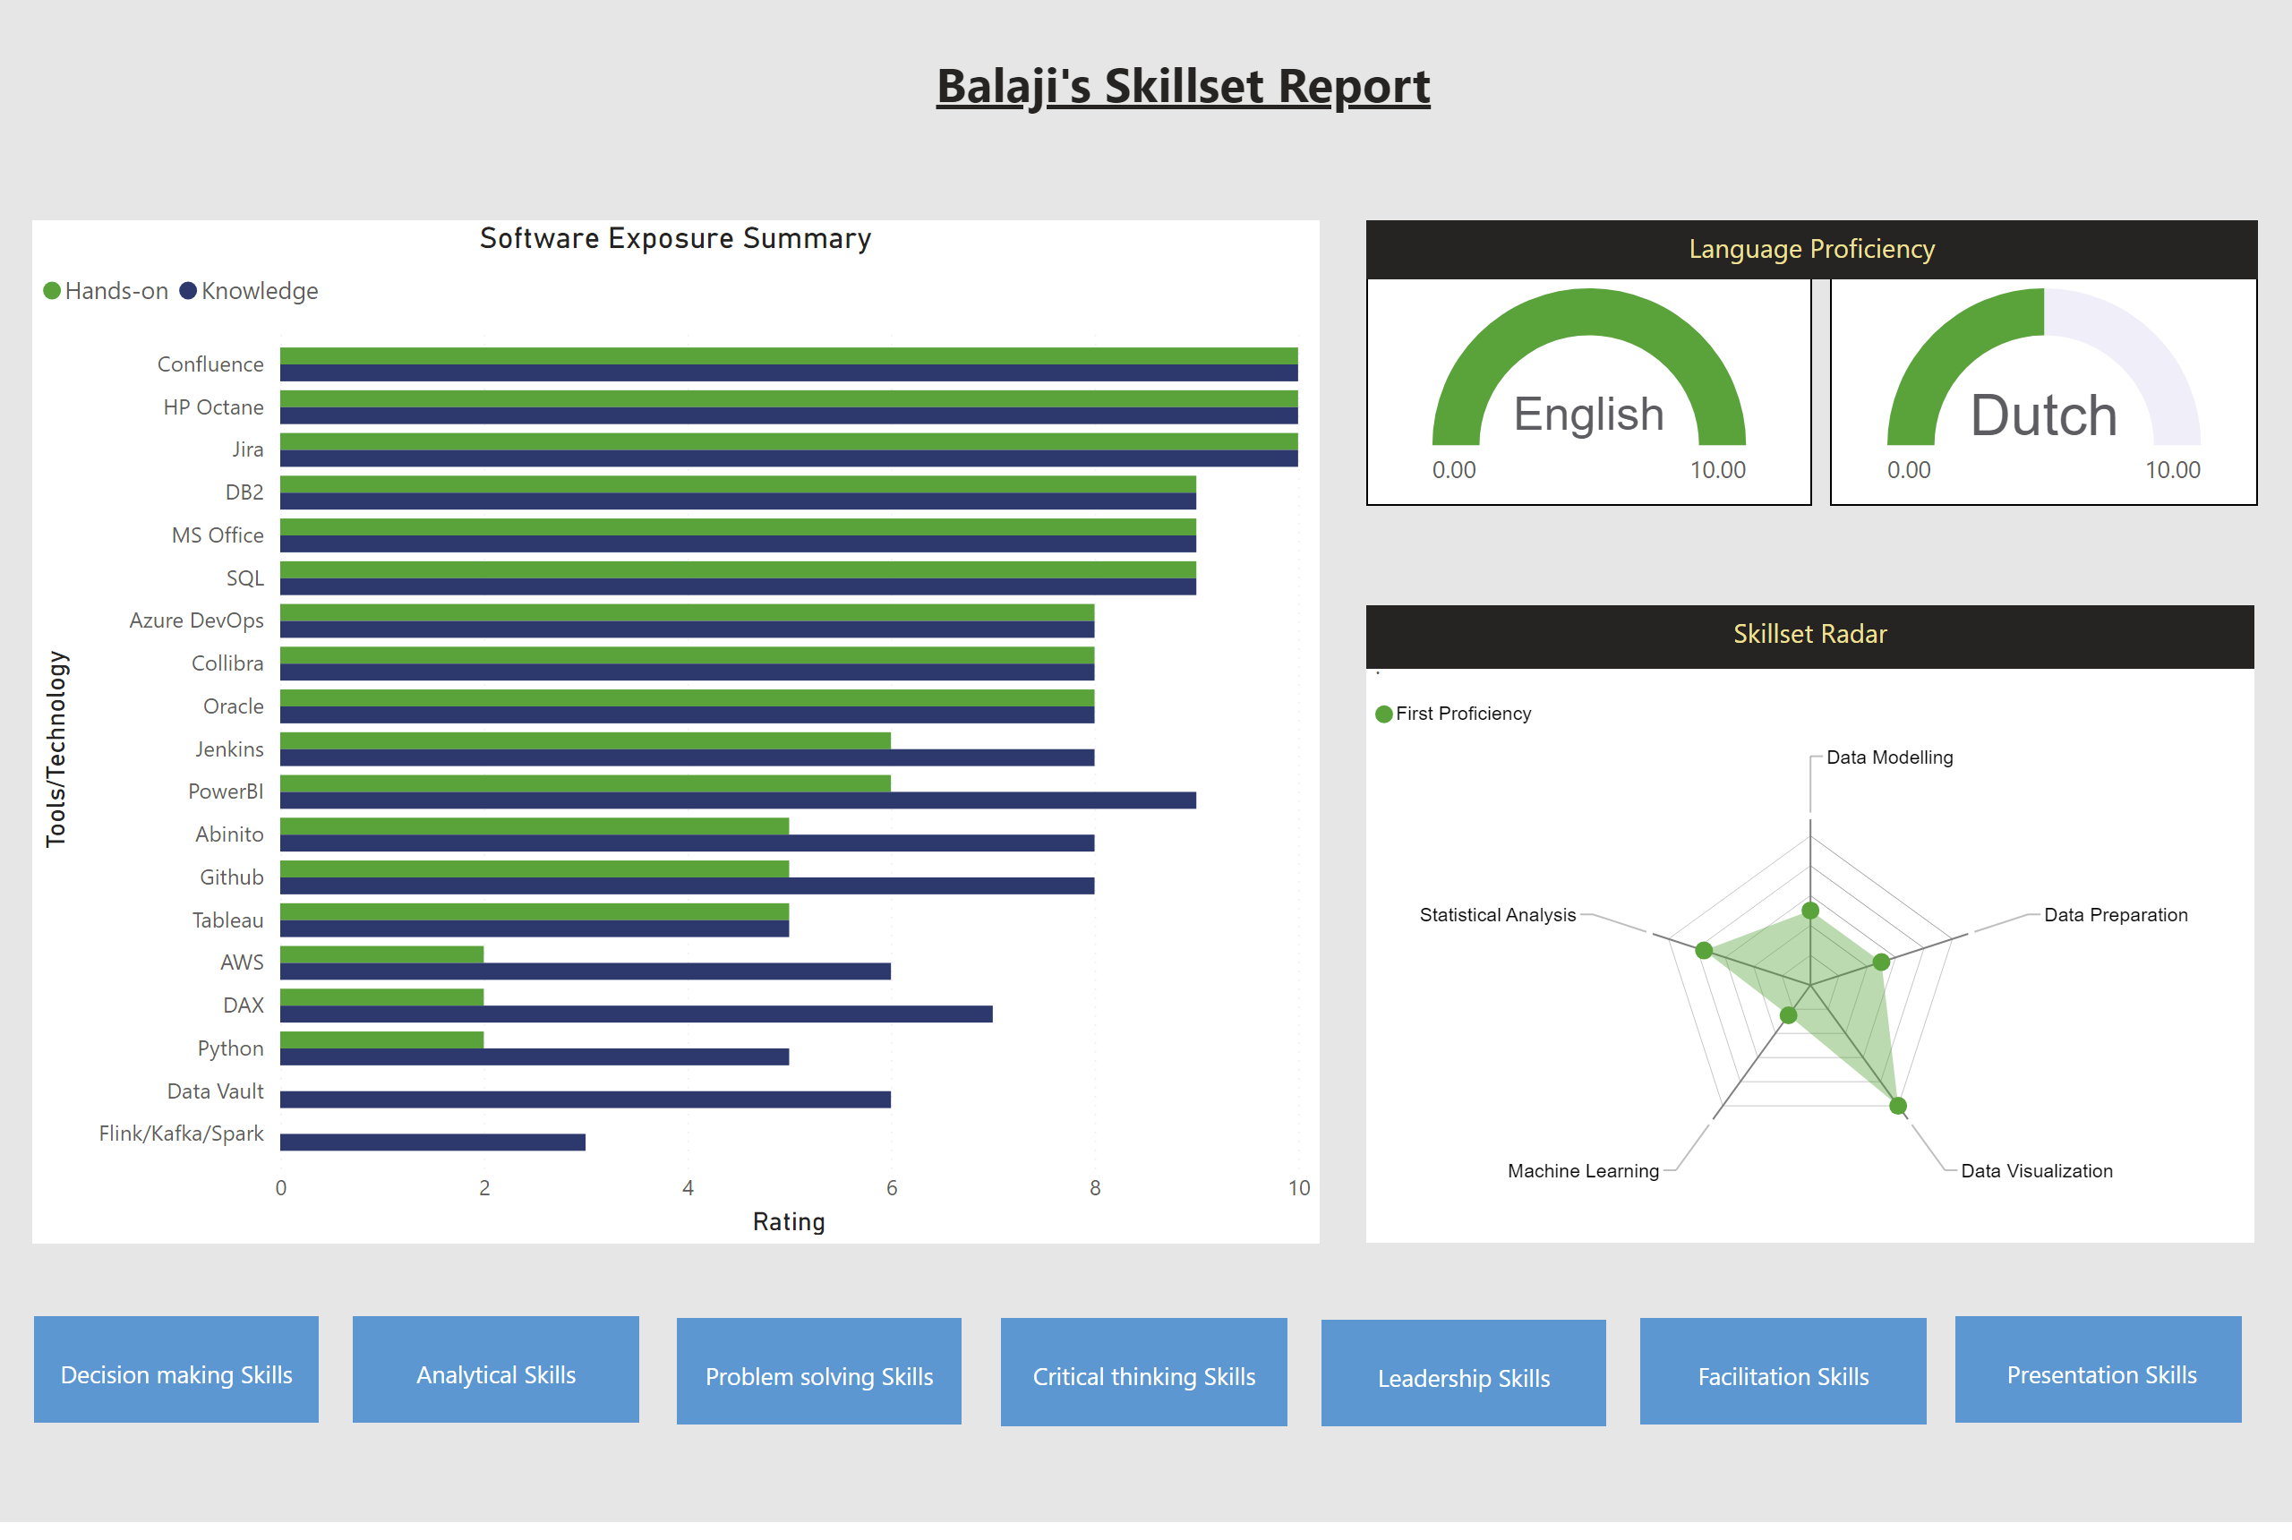
Balaji
Notes:
English
No alt text provided
gauge
No alt text provided
textbox
No alt text provided
textbox
No alt text provided
Software Exposure Summary
No alt text provided
.
No alt text provided
textbox
No alt text provided
textbox
No alt text provided
textbox
No alt text provided
textbox
No alt text provided
textbox
No alt text provided
textbox
No alt text provided
textbox
No alt text provided
textbox
No alt text provided

